Slide 1

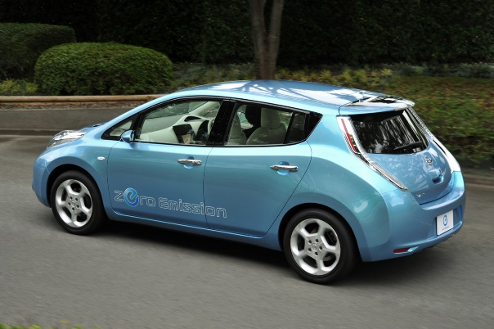
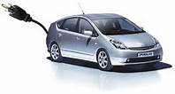
Trustworthy Cyber-Physical Infrastructure for Electrical Vehicles
Klara Nahrstedt
University of Illinois at Urbana-Champaign

Slide 2
Outline
Motivation
Challenges of EVs Physical Infrastructure
  Wireless charging
  Electrification of roads
Challenges of Cyber Infrastructure
  Trustworthy EV’s data collection for energy management
  Placement of EVs charging devices
Conclusions

Slide 3




Motivation (Why EVs?)
Beijing pollution
New York Pollution
Paris pollution
LA Pollution vs Cheyenne
Notes:
EV decreases CO2 by 50%

Slide 4
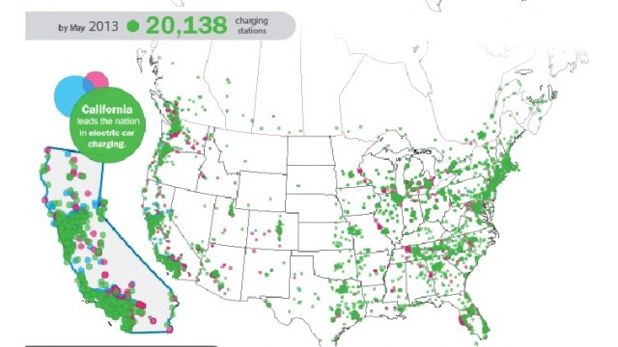
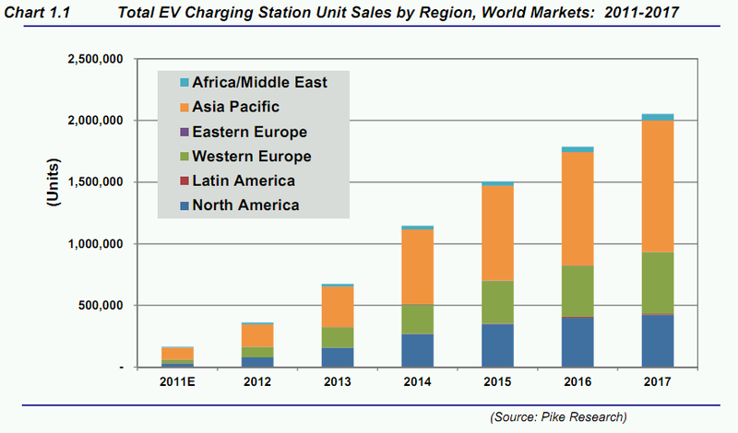
Motivation
Increasing popularity of Electric Vehicles (EVs).
Limitation: access to public charging facilities.
http://www.greencarcongress.com/2011/08/pikeevse-20110824.html
Notes:
Nissan leaf 2011 - 73 miles on fully charged battery.
Tesla Model S 60 - 94/97 (CTY/HWY) miles on fully charged battery

Slide 5
Advances and Challenges of Electric Vehicles

Slide 6
Advances and Challenges of EVs
Goal:
  Electric mobility Beyond 2020!!
    Eco-friendliness, safety, comfort, efficiency
Challenges
  EV Charging
    Charging Stations
    Static Wireless Charging
    Dynamic Wireless Charging
  Electrification of Road Infrastructure
  Design of Electric Vehicles themselves
    Battery (size, weight, temperature, capacity)

Slide 7
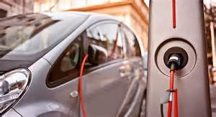
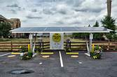
EV Charging - Charging Stations (1)
In USA by 2020 first stage of major EV deployment
In form of Hybrid Plug-in Electric Vehicles (PEV)
Volvo anticipates huge Hybrid EV technology
revenue increase
Pike Research forecasts by 2017
  1.5 M of charging stations
  5.1 M PEVs in USA
  EV supply equipment (EVSE) drops
  by 37% (Gartner)
Car Metrics to consider
  BMWi3 car
    12.9KW per 100 km
    acceleration time 0-100km/h takes 7.2 seconds
    Number of speeds: 1 speed (corresponds to
    1 gear)
    Number of miles per battery
http://www.greencarcongress.com/2011/08/pikeevse-20110824.html

Slide 8
Charging Stations (2)
Challenge: Where and Who installs charging stations?
  Case study in Brussels (mentioned at ICEV’14):
    On public land (e.g., public parking space) only utility company can install charging stations; utility charges for electricity
    Parking company 3rd party should only charge for space
      But often parking company charges for parking space and usage of charging station; user pays twice
    On private land (e.g., private garage) 3rd party company installs charging station and charges for electricity

Slide 9
Charging Stations (3)
Challenge: More PHEV than charging stations
  Where do we place them?
  Do we establish reservation system?
  What will happen to other drivers?
  Is inductive charging the solution?

Slide 10
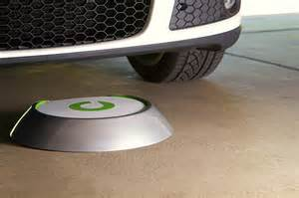
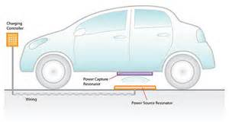
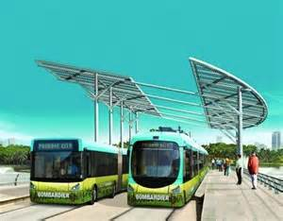
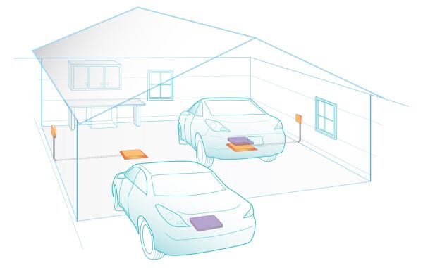
EV Charging - Static Wireless Charging (1)

Slide 11
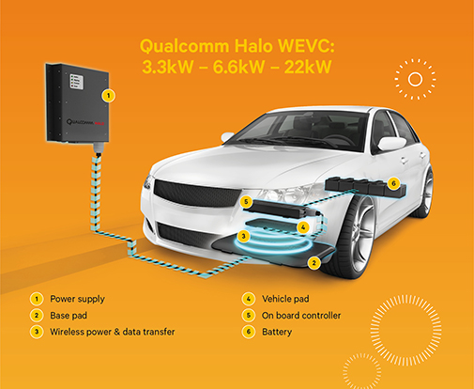
Static Wireless Charging (2)
Technology: ICET – Inductive Contactless Energy Transfer
Challenges: weak coupling factor, lower efficiency, high magnetizing
Solution: bidirectional inductive contactless energy transfer (CET)
CET systems used for
  Sensor actuators (microwatt power range)
  EVs (hundreds kilowatts)
Current efficiency of ICET
  80-95% for 10-40cm distance

Slide 12
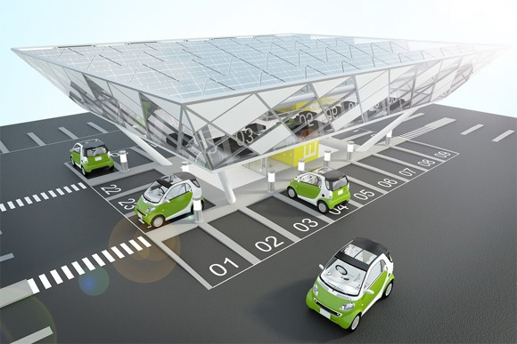
Static Wireless Charging (3)
Challenge: People are concerned regarding safety
  Electric power is transferred through air
  Tests are going on at ORNL
Challenge: Long and Trusted Charging

Slide 13
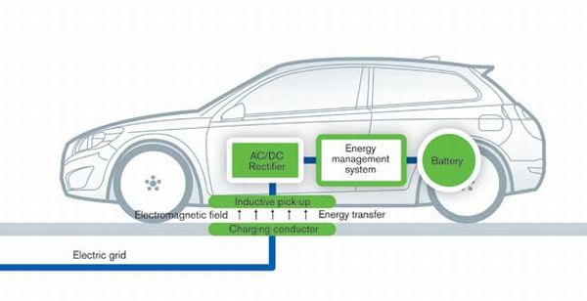
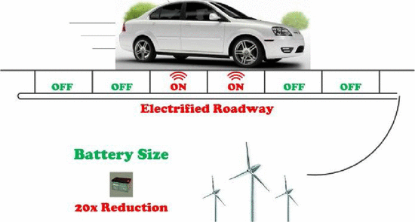
EV Charging - Dynamic Wireless Charging (1)
Cons
  Expensive infrastructure
Use Cases
  Urban environments
  Long distance
Pros:
  Smaller battery
  Cheaper EV
  Extended driving range
  Extended battery lifetime
  Reduced anxiety
  Energy efficiency
  Comfort
  Increased mobility
  No visual pollution
Wu, H.H.; Gilchrist, A.; Sealy, K.; Israelsen, P.; Muhs, J., ``A review on inductive charging for electric vehicles,’’ in Proc. of IEEE IEMDC 2011

Slide 14
Dynamic Wireless Charging (2)
Challenge: Impact on EV speed
  if we have 2 m long coils of 20 KW, one needs to go slowly at 36 km/h
  If one goes at 108km/h, one has only 200ms charging time
Challenge: Impact on Power Grid
  Simulation study by FABRIC project:
    If one considers average 10 EV/km/lane over 1 hour with 500 simulated EVs with max capacity 30 EV/km/lane, then one can achieve 2-8 MW load demand
    We will need energy storage system if demand fluctuation which will be the case
    Energy storage systems can minimize demand variability
      Overall peak load reduction will be less expensive
    Load shaping and shaving is needed!!!

Slide 15
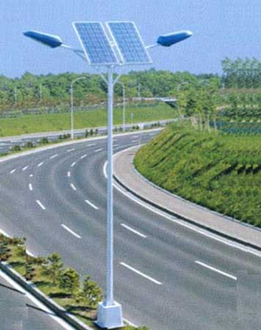
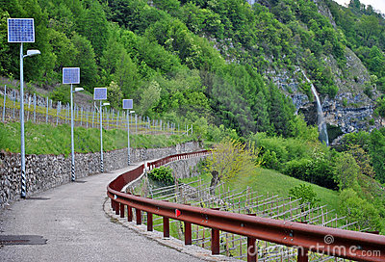
Dynamic Wireless Charging (3)
Further Challenges:
  Communication latency
  Infrastructure issues for Power grid distribution
  Coil sequencing
Electric roads may need solar panels next to the road to provide electricity

Slide 16
Electrification of Road Infrastructure (1)
ORNL is conducting dynamic roadway projections
  Estimate cost and impacts for electric roadway given
    Current vehicle information from supporting lab data
    Current electric vehicles
  Estimate cost and impact for electrified roadway given
    40 miles per hour vehicular speed
    Charging pads with 11 KW for small vehicle to keep it charged
First Results of Projections for Atlanta
  If we consider 25-30KW, estimated 30% lane coverage, it would cost $2.8M per Mile of electrified road per lane

Slide 17
Electrification of Road Infrastructure (2)
Challenges:
  Cost of dynamic WPT on vehicle
    What is the impact of WPT on vehicle (size of battery)?
  How do we pay for road electrification?
    Road use cases – toll roads, taxes
  Where do we place charging pads?
    Case study – I-75 South Atlanta

Slide 18

Electrification of Road Infrastructure (3)
Challenges for Wireless Charging:
  Road material for on-the-road charging
  How do we deal with water, snow, sand, ice, clay, etc on roads?
    There is loss when roads are wet. (Wet road causes electromagnetic loss)
    We need different material to minimize loss even in wet conditions.
  How do we deal with structural integrity of road?
    Roads can crack, have rutting problems
    We need devices to test roads for structural integrity.
Source: KTH Smart Road Infrastructure Project

Slide 19
Electro-Mobility Impact on Power Grid

Slide 20
Cyber-Physical Infrastructure
Road:
  Sensors on/in the roads (coils) in case of dynamic wireless charging, signaling, other road functions
  Road Side Units (RSU) next to the road for capturing, processing and communicating wirelessly sensory information (cell towers, wireless access and processing points)
EV Car:
  Mobile smart meter to measure charging levels and usage levels
  Other sensors monitoring other functions of car services
Power Grid Utility:
  Cloud computing and storage to store and process all the sensory information and provide power grid services
Road Services and 3rd Party Services:
  Cloud computing and storage to store, process and share related contextual information offered in conjunction with power grid services

Slide 21
Impact on Power Grid – Processing
Challenge: Provide IT Services in Power Grid for EVs
  Represent and Process Information via Algorithms towards
    Accurate range estimation
    Navigation - Cooperative IT system allows for robust traveling via re-routing
    Assignment of charging stations
    Placement of charging stations and charging pads
Challenge: Enable Seamless Information Integration related to Power Grid Infrastructure, Trustworthy IT Infrastructure, EV Design, and Road Infrastructure (with wireless charging)
  Large number of sensors (EV, road, power grid, people)
  Different information representation
  Different communication technologies
  Different digital and energy storage capabilities
  Mobility issues
  Different security and privacy capabilities and demands

Slide 22
Impact on Power Grid - Processing
Challenges for Business Models: Big Data
    Cost-benefit analysis
    Environmental life-cycle assessment
Challenges for Charging Concepts: Real-Time
    Vehicle authorization
    Charging profile negotiation
    Monitoring of power transfer while EV is over pads
    Billing and payment
    Coordination of WPT hardware with information control transmission

Slide 23
Impact on Power Grid - Access
Challenge: Make available power grid information with high integrity to ensure:
  Power service continuity
  Flexibility and extendibility,
  Monitoring of demand growth
  Electrical efficiency
  Operational efficiency
  Power quality
Challenge: Deal with large power fluctuation due to power transfer design, effect of traffic conditions
    Deal with Variable number of vehicles in lanes in case of WPT

Slide 24
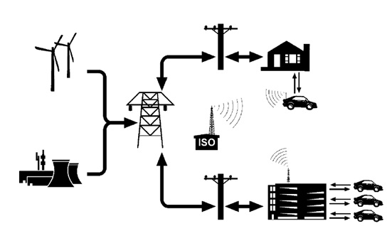
Impact on Power Grid - Communication
Vehicle-to-Grid Communication
Challenges:
  Real-time Digital Communication of Status/Control Information
    Availability and integrity of information
  Real-time Authentication
    Identification, authorization, authentication, verification
  Location Privacy

Slide 25



Interesting Problem - Real-Time Authentication
Assumption: Possible Business
Model
Manage subscribing EV’s information
Bills the EVs monthly
Charging Service Provider (CSP)
Pad Owner A
Pad Owner B
Subscribe to a CSP
Make monthly payment
Operates charging pads
Receives energy from some utility
Hongyang Li, Gyorgy Dan, Klara Nahrstedt, “PORTUNES: Privacy-Preserving Fast Authentication for Dynamic Electric Vehicle Charging; IEEE Smartgridcom 2014
Hongyang Li, Gyorgy Da, Klara Nahrstedt., "Proactive key dissemination-based fast authentication for in-motion inductive EV charging," IEEE ICC, SAC-Communications for the Smart Grid, June 2015, London, Great Britain

Slide 26


System Model: Communication
CSP (Charging Service Provider) to PO (Pad Owner) – via high-speed network
PO to Pad – power line communication
CSP to EV – via cellular or RSU
EV to pad wireless communication
  Transceiver vertical distance: h
  Wireless comm. range: r
  Contact time ~20ms@30m/s (r=0.5,h=0.3)
r
h
Pad 11
Pad 1p
Pad P1
Pad Pp
PO 1
PO P
Network (HSN)
CSP 1
CSP C

Slide 27
System Model: Attacker
Capabilities
  Computationally bounded
  Has access to communication channels
  Cannot tamper with CSP, PO, pads
Objective
  Electricity theft
  Denial of service
r
h
Pad 11
Pad 1p
Pad P1
Pad Pp
PO 1
PO P
HSN
CSP 1
CSP C

Slide 28
Design Goals
Authentication
  Pad should charge authenticated EVs only
  Enable accurate billing
Privacy
  Do not allow pad owners to track EVs among pads
Efficiency
  Allow speeds up to 30m/s
Simplicity
  No real-time communication between charging pads

Slide 29
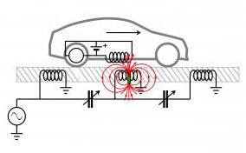
Why not (a)symmetric key cryptography
Asymmetric key cryptography
  Privacy – Can infer the EV’s route by tracking its public key
  Computational complexity – Only few milliseconds contact
  Overhead – Signed certificate or real-time CA query
Symmetric key cryptography
  Replay attack (space or time)
  DoS (space and time)

Slide 30
Portunes - Building Blocks
Asymmetric keys
  CSP-EV and CSP-PO
One-way function f
  CSP-pad
Symmetric keys
  PO-pad
Time and location information
  Clocks are synchronized within 200ms
    E.g., synchronize RTC with GPS every 30 minutes
  Pad knows its location l_{p}
CSP 1
CSP C
PKI
PKI
PKI
PKI
f_{CO}
f₁₁
EV
PO 1
PO P
K₁₁
K_{P1}
f₁₁
f₁₁
K_{1p}
f_{CO}
f_{CO}
K_{Pp}
Pad 11
Pad 1p
Pad P1
Pad Pp

Slide 31

Portunes - Protocol Overview
CSP
Pad Owner

Slide 32
Phase 1: Key Pre-distribution
: pseudonym
CSP
: one-way function that maps pseudonym to key index
key index
Pad Owner

Slide 33
Phase 2: Authentication
CSP C
EV e
If timestamp valid: Provide charging pad’s location to assist EV location estimation
Expensive but happens once
Broadcast
periodically
This reply is optional.
Must match
Validate timestamp and location stamp (ε_{t},ε_{l})
Charging pad p
Locate session key

Slide 34
Security – Replay Attack
Location estimate accuracy
  GPS accuracy within 2.2m with 95%
  Assisted location estimate
Replay attack
  Location stamp prevents replay at another charging pad
    For ε_{l}=1m, v=30m/s,ε_{t}=200ms → pad to be within 6m
  Time stamp prevents replay at another time (within 2ε_{t})

Slide 35
Privacy & Trust
Privacy
  Location privacy provided by pseudonym
  Only CSP knows the pseudonym mapping
Trust
  Charging base on PO’s report to CSP
  Reporting accuracy check by test-driving

Slide 36
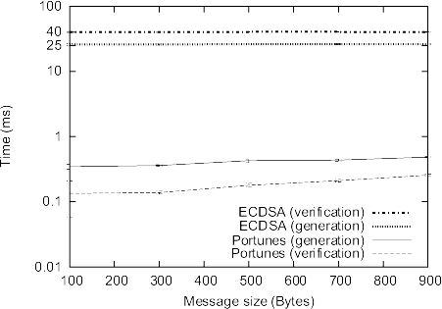
Computational Complexity
Raspberry Pi Model B
  700 MHz CPU
  512 MB RAM
  Less than $40 (USD)
LibCrypto++
Algorithms (128 bit security)
  ECDSA P-224 (448bit)
  AES-CFB
ECDSA beaconing
  every 1.2m at 30m/s
Raspherry Pi implements EV algorithms!
Conclusion

Slide 37
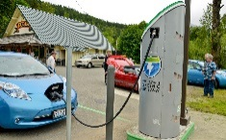
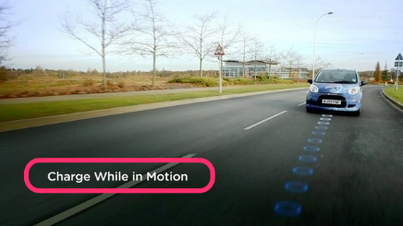

Other Interesting Problem – Assign Charging Devices
Link information:
  Length in unit
  Traffic flow in veh/hr
Goal: find optimal locations for charging facilities to serve the most traffic flows.
Constraint: budget.
Approach:
Flow Refueling Location Model (FRLM)
B
5, 50
5, 80
8, 150
A
D
5, 10
5, 30
C
Optimal Placement of Charging Stations and Dynamic Wireless Charging Pads
joint work with Siting Chang and Hongyang Li, IEEE ICEV 2014

Slide 38

Eligible Combination
Eligible combination of OD (Origin Destination) pair is a candidate combination which could ensure EV to complete a round trip from O to D.
State of Charge (SOC). E.g. 6 unit.
Candidate combination: {B, AD}
  {B, AD} is an eligible combination of Flow AB.
  {B, AD} is not an eligible combination of Flow AC.
12
1
B
6
7
5, 50
5, 80
A
D
1
5, 10
5, 30
C

Slide 39
Approximation Solution
We follow steps:
  Pick candidate paths to assign only charging pads.
  Make rest of the nodes candidate sites to assign charging stations. Note: pads and stations cannot overlap.
  Determine which path(s) to assign charging pads and which node(s) to assign charging stations.
To locate:
1 charging pad
1 charging station
B
5, 50
5, 80
A
8, 150
D
5, 10
5, 30
C

Slide 40
Sample Network
Goal:
To locate: 1 Charging station, 1 Charging pad
On: 1 Candidate link ,2 Candidate nodes
B
5, 50
5, 80
8, 150
D
A
5, 10
5, 30
C

Slide 41



Coefficient matrix
Candidate location
B
5, 50 (1)
5, 80 (3)
Combination
A
8, 150 (5)
D
5, 10 (2)
5, 30 (4)
Combination
C
Combination 1 ( h1 ): 170veh/hr
Combination 2 ( h2 ): 280veh/hr
Combination 3 ( h3 ): 190veh/hr
Flow

Slide 42
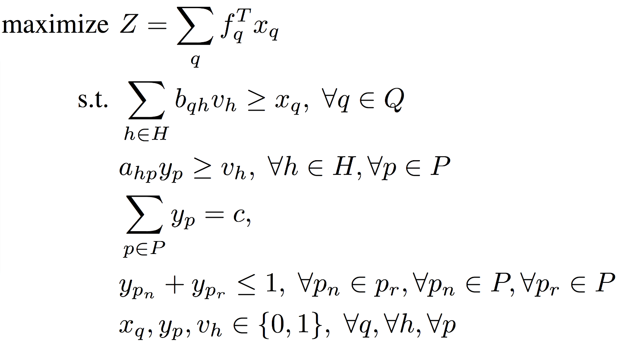
Optimization among charging stations if constraints exist
Maximize the flows being refueled
Flow is captured if at least one eligible combination is selected
Combination is considered selected if all facilities required by the combination are assigned with charging stations
Fix the number of charging facilities to locate
No overlap of stations and pads
Binary variables
Notes:
Animate constraints, change order

Slide 43
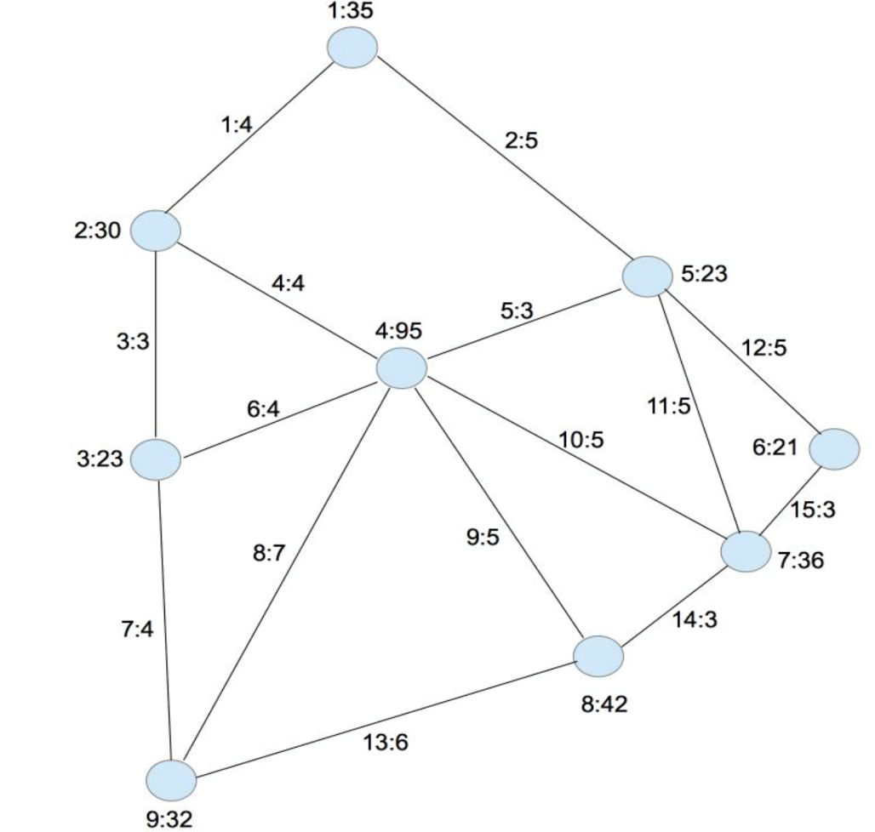
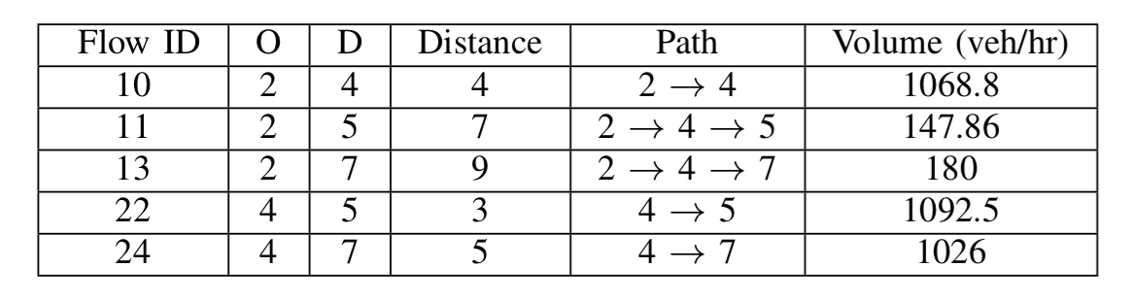
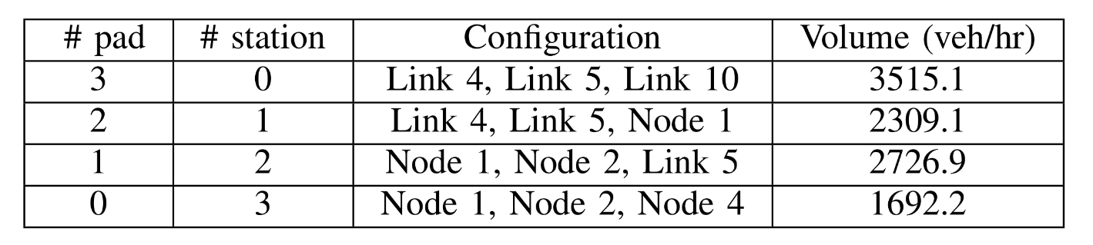
Evaluation
Charged Traffic flows
Charged Traffic flows with different combinations

Slide 44
Conclusion
EV community plans for 2050
  Tremendous engineering and scientific problems need to be solved until 2050
    Wireless charging, new materials, heterogeneity, …
EVs, Power Grid, Roads are all becoming cyber-physical systems
Information will be acquired, stored and processed leading to
  Big Data problems (volume, velocity, variety, value, visualization…)
  Information Representation and Integration problems (many stakeholders)
Information will be communicated in trustworthy manner leading to
  Security and privacy problems (access control, authentication, ..)
  Information Reachability problems due to mobility
  Heterogeneous communication problems (latency, losses, …)
  Integrated social, vehicular and road network problems

Slide 46
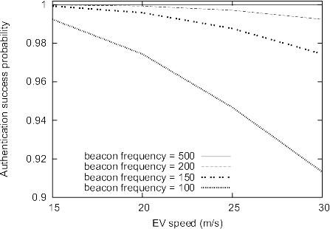
Authentication Success Probability
Beacon frequency b
Frame error probability s
Wireless range r
Transceiver vert.sep. h
EV speed v
Authentication success probability
Beacon is sent from EV to Pad

